Slide 1

Telemetry for Business Central ISV product owners
“It’s as simple as 1, 2, 3”
Notes:
Photo: https://www.pexels.com/photo/brown-firewood-122588/

Slide 2
Telemetry is just a fancy word for “usage data”
Data
Insights
Actions

Slide 3
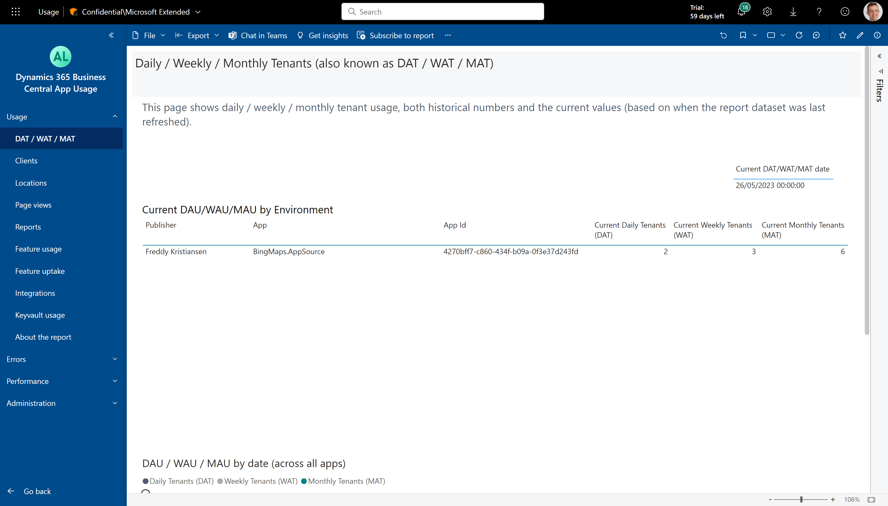
Daily/Weekly/Monthly Active Tenants (DAT/WAT/MAT)

Slide 4
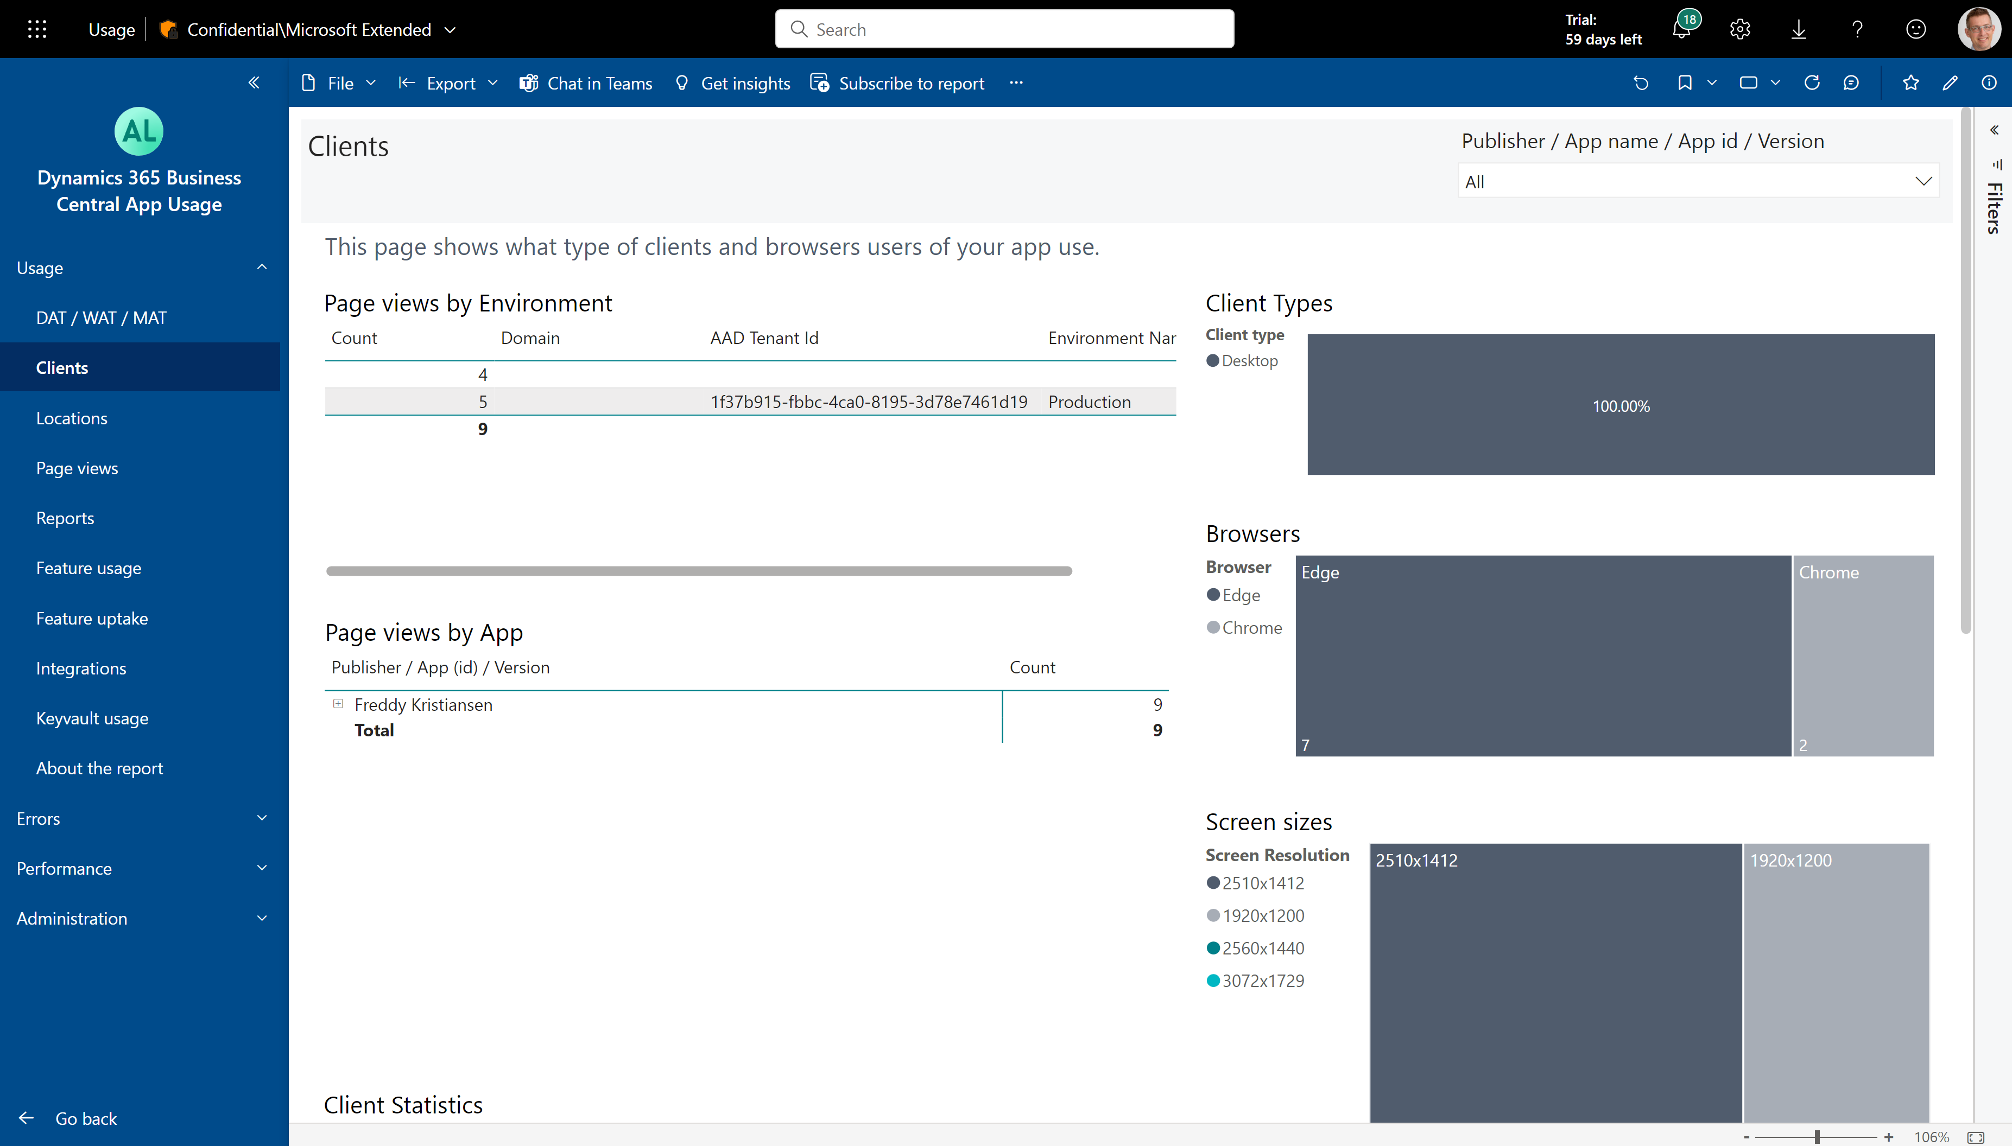
Types of clients and browsers using your app

Slide 5
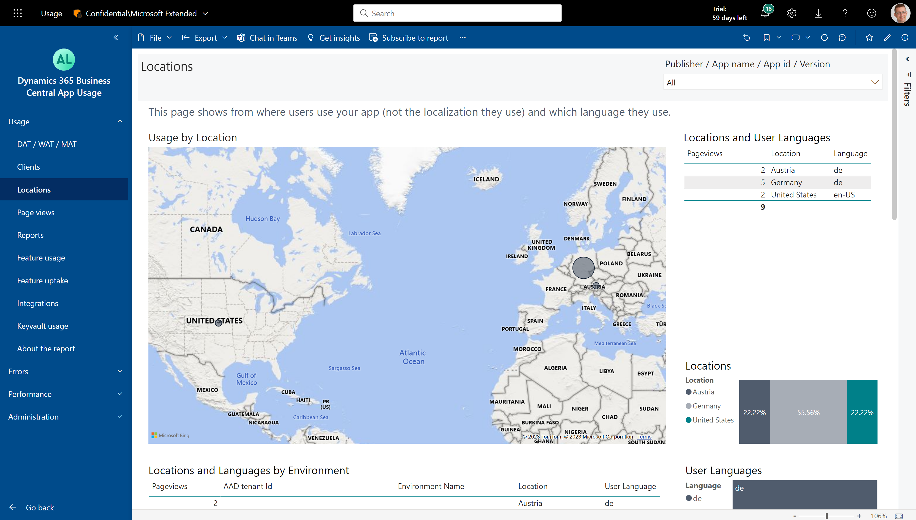
Where are your customers and which languages do they use?

Slide 6
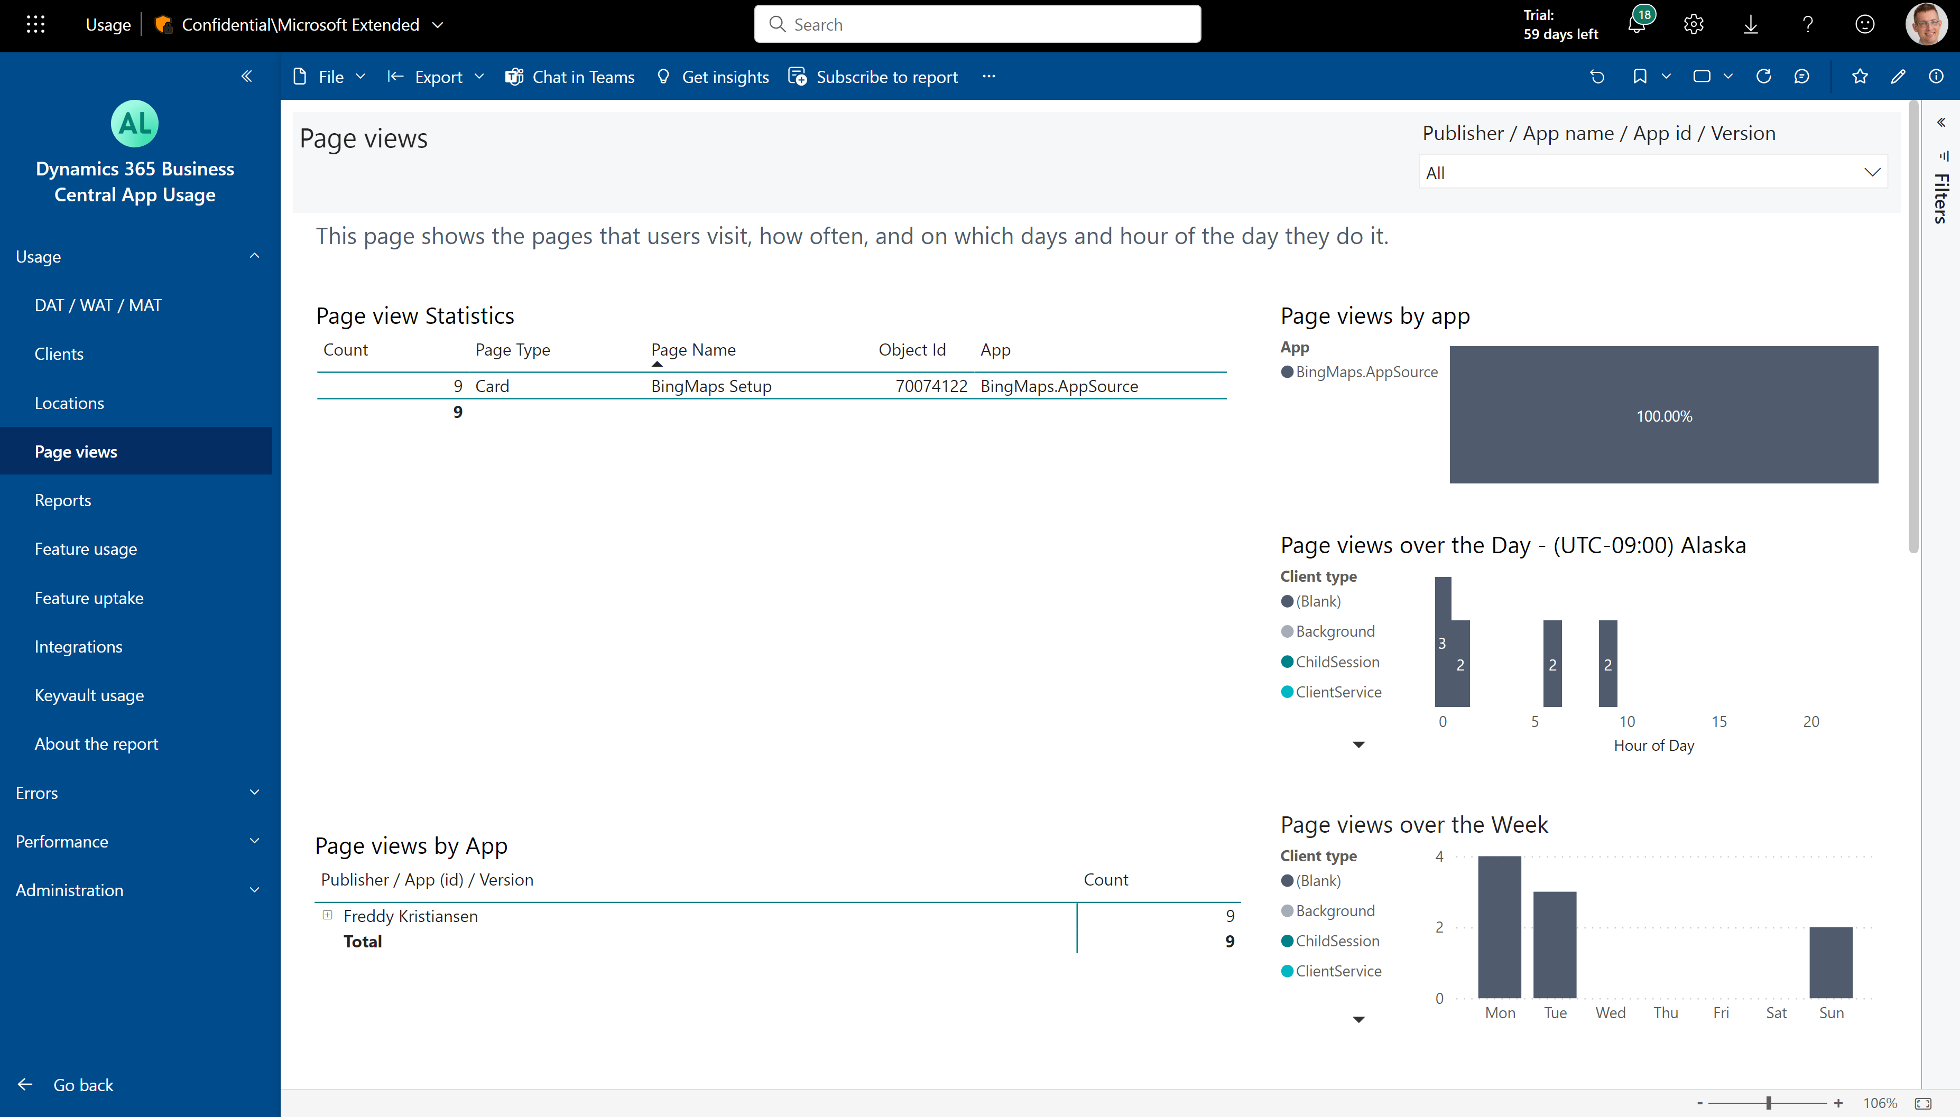
What are page view usage patterns for your app?

Slide 7
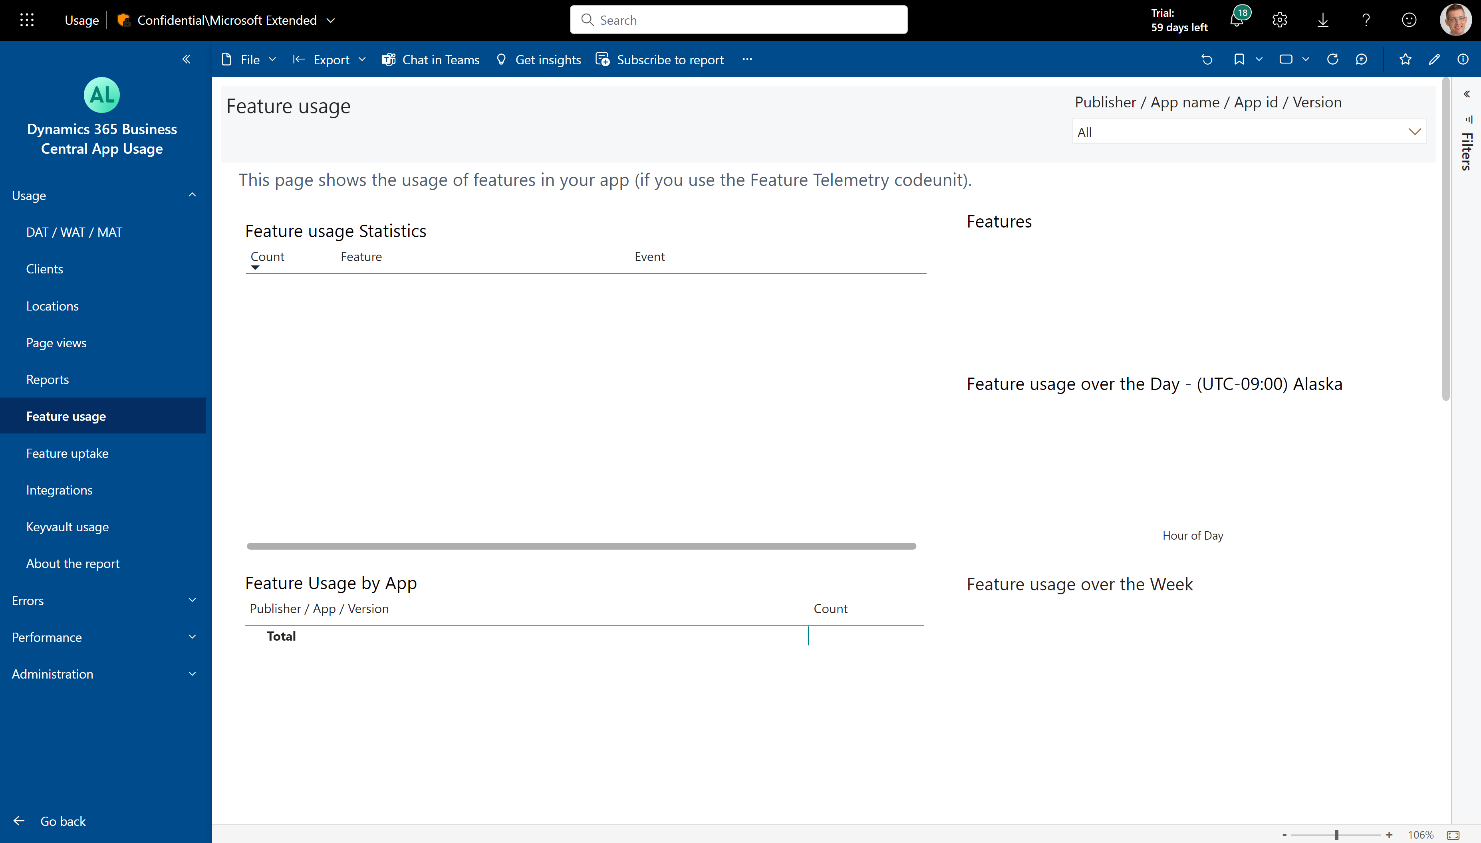
Which features in your app are being discovered/used?

Slide 8
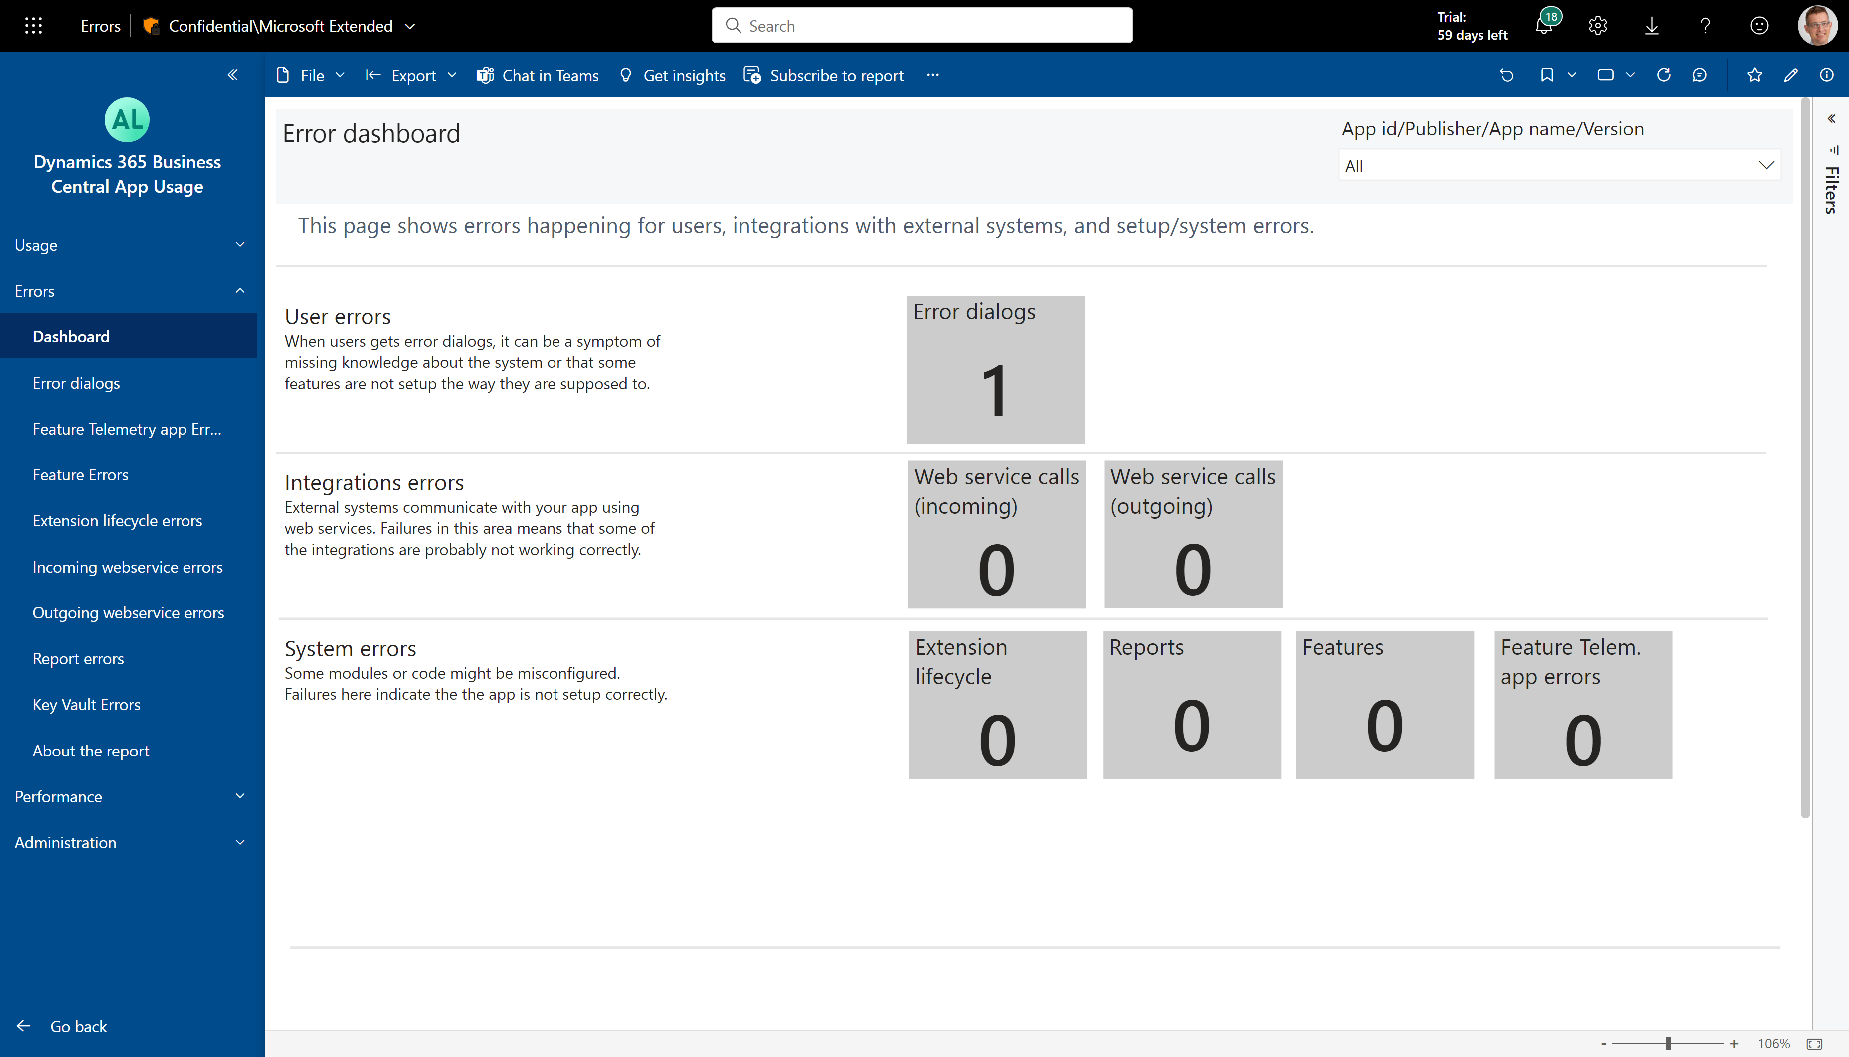
Which errors happen in your app?

Slide 9
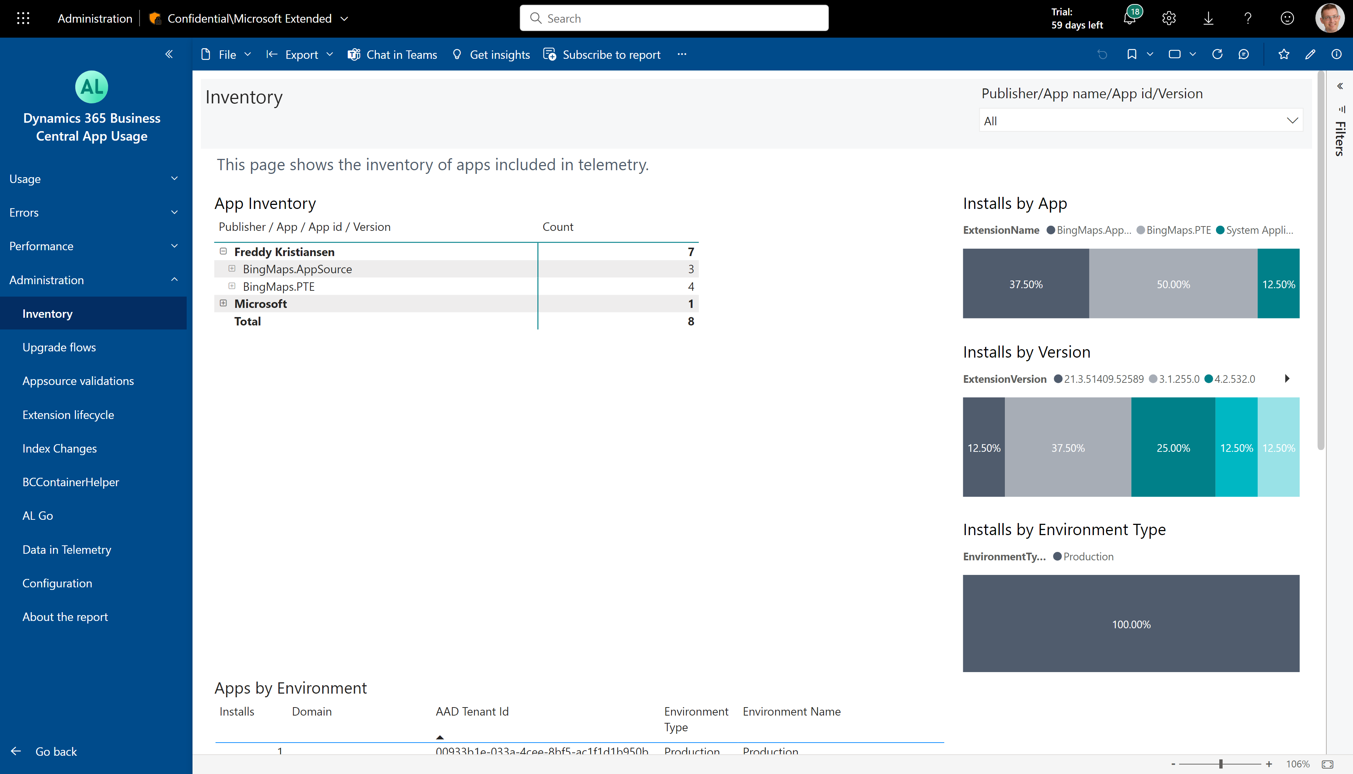
How to see your install base across customers

Slide 10
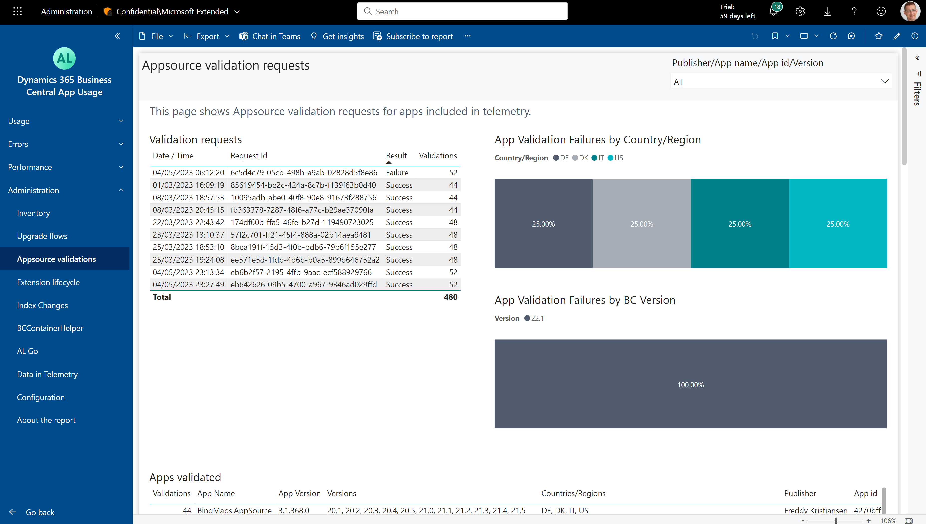
How to see the Appsource validation results
See failures by country/region
See failure rates by version

Slide 11
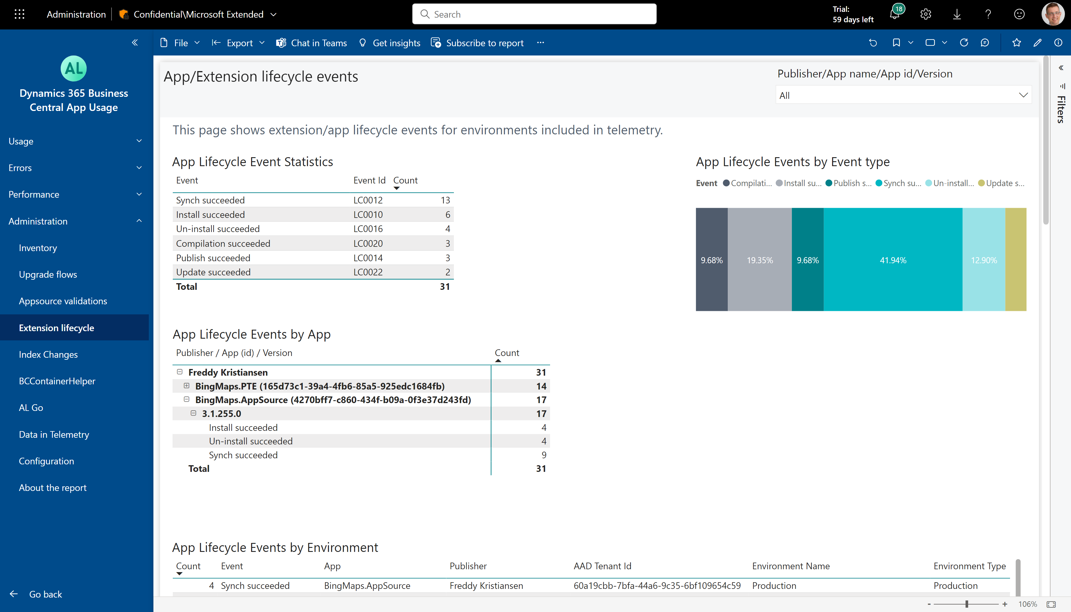
How to see the app lifecycle events (including errors)

Slide 12
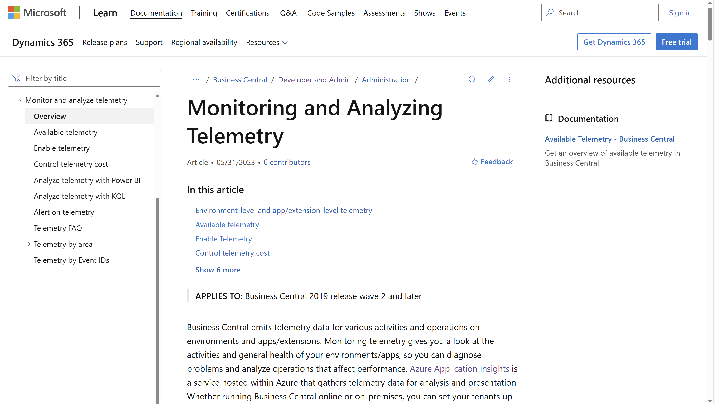
aka.ms/bctelemetry

Slide 13
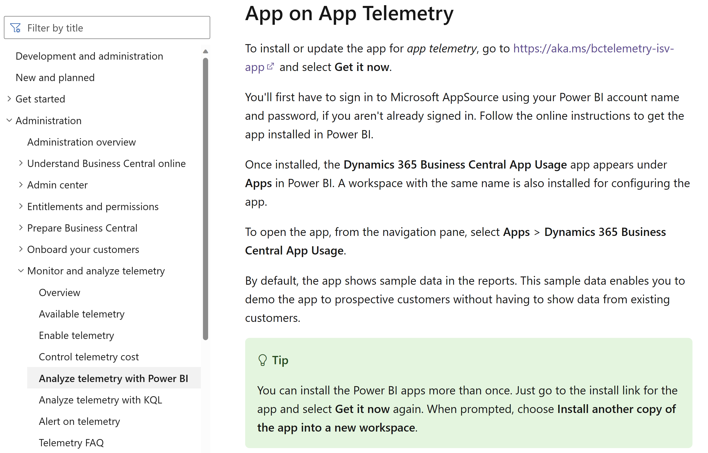
How do I get the Power BI app?

Slide 14
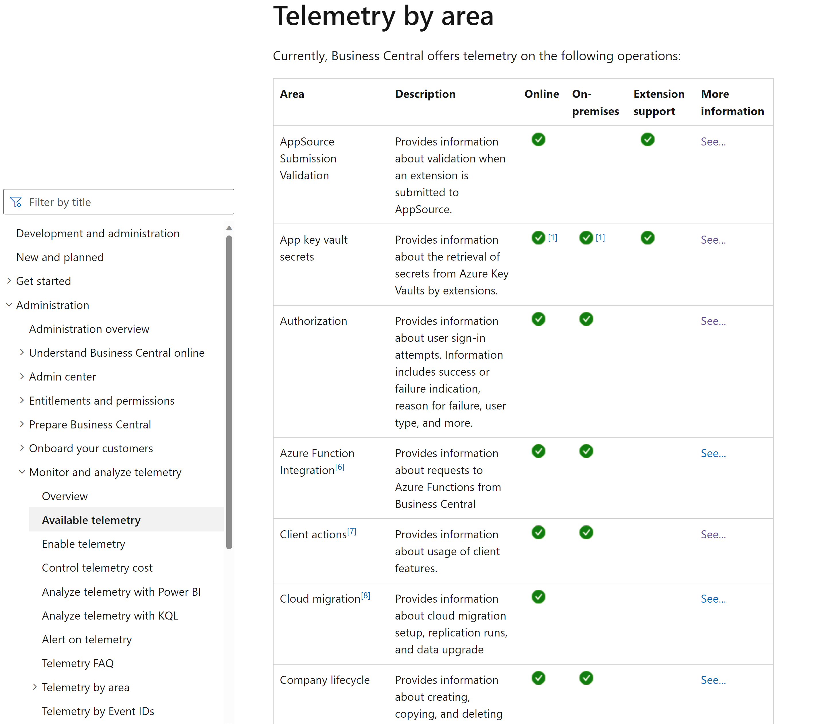
What signal is available for ISVs?

Slide 15
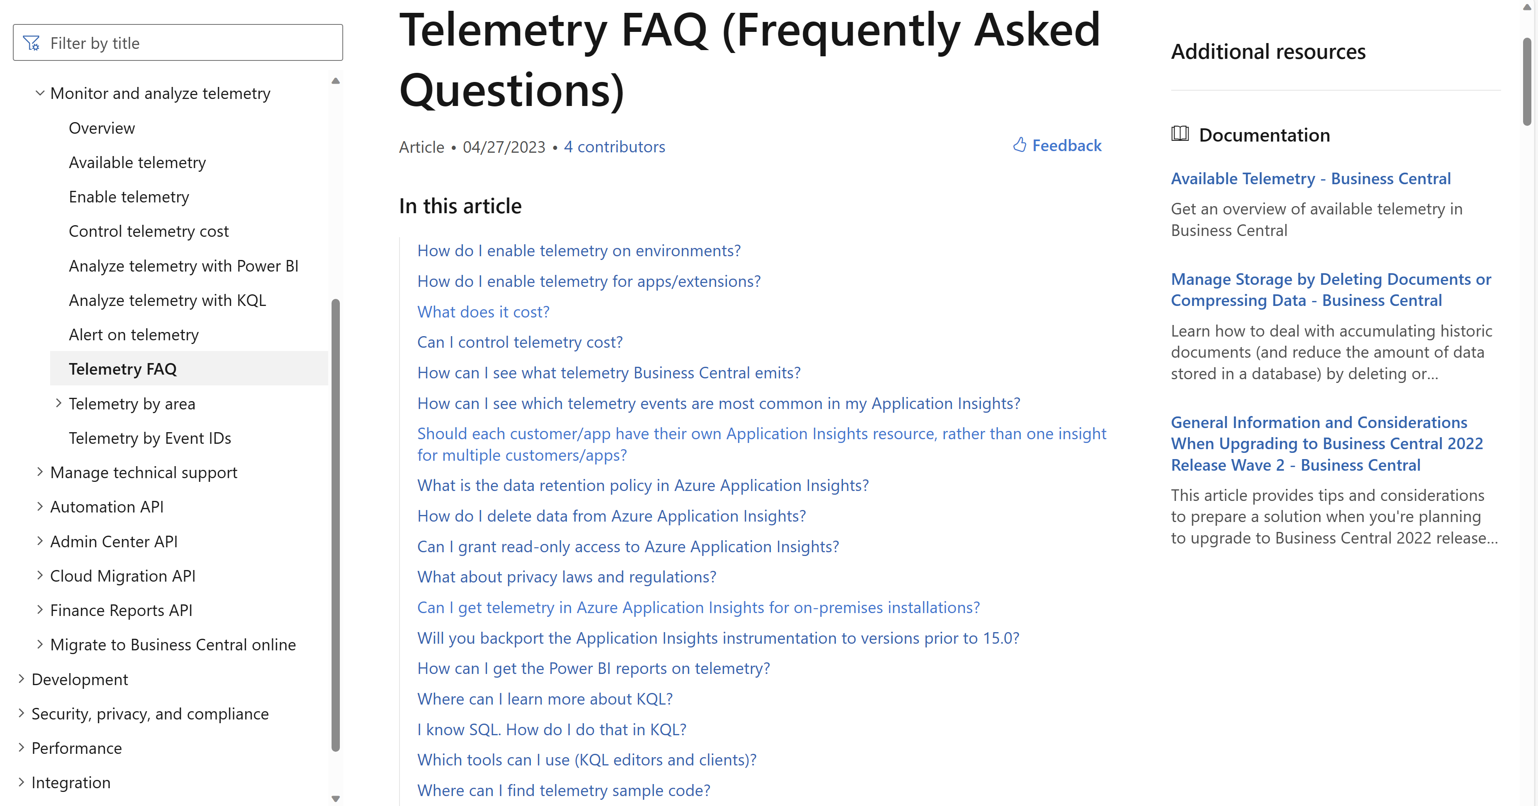

Slide 16
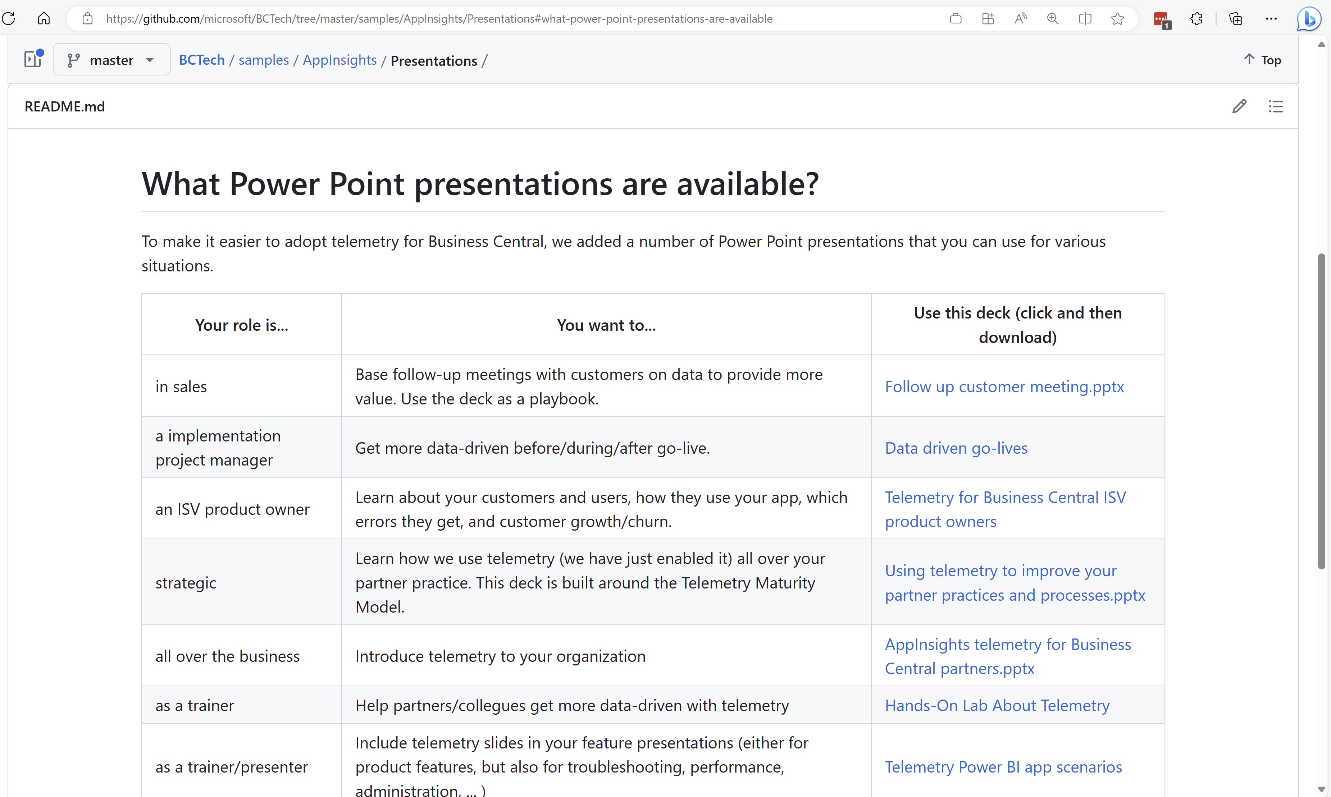
aka.ms/bctelemetrysamples

